Slide 1





Information Literacy: why, what, when, how?
Letramento informacional: o quê, porquê, como, quando?
Albert K. Boekhorst
Notes:
Boa tarde senhoras e senhores. Infelizmente meu Português é limitado, por isso vou continuar em Inglês, mas eu tenho certeza que você vai ouvir uma excelente tradução.
First of all I want to gratulate University of São Paulo with it’s 30th
anniversary of it’s Library System and thank you for the honor to invite me to be here and able to address you.
I’m an information scientist, retired from the University of Amsterdam in the Netherlands and still a visiting professor at the University of Pretoria, South Africa. My research concentrates on the access to information, especially on information literacy and the role of (school) libraries. Among others I’m the Information Officer of the IFLA Information Literacy section, member of IFLA School Libraries and Resource Centers section, member of the board of ENSIL and member of IASL and the Dutch Library Association. I participated in several UNESCO Expert Group Meetings on Media and Information Literacy and coordinated and participated in the worldwide UNESCO TtT in Information Literacy workshops series.

Slide 2
To survive, develop and relax etc.
People, organisations and nations need knowledge on:
Themselves
Their physical environment
Their social environment
Notes:
People need knowledge to survive, to develop, to relax, to perform tasks, make decisions and solve problems. ... They need knowledge on themselves, their physical environment and their social environment

Slide 3
Information Space
Observation: objects & processes
Conversation: persons
Consultation: stored, recorded information
‘memory institutions’
Both ‘physical’ and ‘virtual’
Notes:
They can find this information in their information space via 3 processes: Observation, Conversation and Consultation.
Observation refers to the ability to look around and observe objects and processes, this is fact-finding by experimenting and authenticating. If I want to know if it’s raining so I’ll take an umbrella, I look out of the window and make a decision.
Conversation refers to the process in which we ask other people: family, friends, colleagues and experts for the information we need, face-to-face, by phone, by e-mail. So if I want to know if I have to take an umbrella, I can call my sister and ask her. She can look out of the window and decide, maybe she can even inform me better, because she has heard the weather forecast.
Consultation refers to the process in which we consult information professionals working in libraries, archives, museums, information institutes and information departments in organisations. This is called stored or recoded information. Due to technology push and users demands long existing walls and traditions between them are disappearing and we call them ‘memory institutions’ now.
All three processes take place in the ‘real’ world were we can touch the objects and the ‘virtual’ world, that we can only access with digital technology.

Slide 4
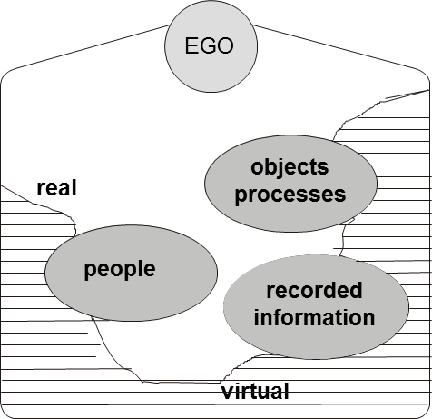
Personal information space
physical
Notes:
Each of us has a personal information space were we can find the relevant information resources. It’s created automatically when we are born and it develops and expands during our lifetime when we grow older: our learning and working carrier, our social contacts and so on. When we grow very old the information space will shrink again.

Slide 5
‘Survival of the Fittest’
Those who are better than others capable to satisfy their information needs in an effective and efficient way, are more capable to survive and develop themselves than … those with less advantageous traits ...
After Charles Darwin
"...it is not the strongest of the species that survive, nor the most intelligent, but the one most responsive to change...“
Therefore a need to be ‘Information Literate’
Notes:
Those who are better than others capable to satisfy their information needs in an effective and efficient way, are more capable to survive and develop themselves than … those with less advantageous traits ...
After Charles Darwin
"...it is not the strongest of the species that survive, nor the most intelligent, but the one most responsive to change...“
Therefore a need to be ‘Information Literate’

Slide 6
Informatisation process
Ongoing control over natural forces
→ ‘technization
Ongoing social and technical differentiation
→ ‘differentiation’
Expanding of interdependency networks
→ ‘globalisation’
Notes:
In what I call the informatisation porcess I see three developments:
An ongoing contral over natural forces > technization
An ongoing social differentiation > differentiation
An expanding of interdependency networks > globalisation

Slide 7
Changes
Exponential growth of information, information media, information channels and information services
Growth of technology, tools and applications to retrieve, process and disseminate information
Changes in communication patterns and behaviour
‘Connected’ 24/7

Slide 8

21st century
Working ‘In the Cloud’
Notes:
What we see is an ongoing working in the cloud. No longer do we carry our information with ourself, printed, on cd, dvd or on a stick. The only thing we need is some device, from cell phone to tablet to computer, electricity and a subscription of a provider. But that all needs money ….

Slide 9
But in how many clouds?
Notes:
What we see is an ongoing working in the cloud. No longer do we carry our information with ourself, printed, on cd, dvd or on a stick. The only thing we need is some device, from cell phone to tablet to computer, electricity and a subscription of a provider. And in how many ‘clouds’ are we working? Seperate ones for work and entertainmaent? But that all needs money ….

Slide 10
Information literacy
Increasing complexity of environment leads to need for more skills to select, retrieve and process information
External factors create backlog

Slide 11
American Library Association (1989)
Information literacy is a set of abilities requiring individuals to recognize when information is needed and have the ability to locate, evaluate, and use effectively the needed information

Slide 12
Further
2003 Prague Declaration
  "Towards an Information Literate Society" and Information Society
2005 Alexandria Declaration
  Beacons of the Information Society
2012 UNESCO / IFLA Recommendation
Notes:
The 2003 Prague Declaration was called
"Towards an Information Literate Society" made the connection to the information socity
The 2005 Alexandria Declaration
Beacons of the Information Society to Life long learning
At the moment we are working at a UNESCO / IFLA Recommendation for Media and Information literacy. UNESCO can ask members states to rapport on items for which UNESCO developed a Recommendation. I have drafted the first versions and it’s now under revision.

Slide 13
Aspects
Recognition information need
Translation information need into query
Identification suitable information source
Application knowledge of relevant ICT
Selection, integration, dissemination of found information in an ethical way
Continuous evaluation

Slide 14
E5
1
2
3
4
5
recognize
information
need
formulate
information
query
knowledge
information
sources
knowledge
of ICT
appliations
selection
intergration
dissemination
K
K’
E1
E2
E3
E4
1
= knowledge product
E1
= evaluation moment
Notes:
Next to many definitions, there are many models. I developed this one many years ago. It shows how a person comes from Knowledg moment K to K’. It has Knowledge products and evaluation moment.

Slide 15
SCONUL 7 pillars of information literacy
Recognise information need
Basic Library Skills
&
IT Skills
Distinguish ways of addressing gap
Construct strategies for locating
Locate and access
Information Literacy
Compare and evaluate
Organise, apply and communicate
Synthesise and create
http://www.sconul.ac.uk/
Notes:
This is another one British SCONUL 7 pillars of information literacy

Slide 16
Related terms
Information
literacy
Information
competencies
User training
Library
orientation
Information
skills
Information
fluency
Bibliographic
instruction
User
education
Notes:
There are a lot of terms sometimes used synonymously with IL. For me IL is an embrella concept and all other terms can be considered components of it (?)
Information fluency – Mastery of information competencies
User education – Global approach to teach information access to users
Library instruction – Focuses on library skills
Bibliographic instruction – User training on information search and retrieval
Information competencies – Compound skills and goals of information literacy
Information skills – Focuses on information abilities

Slide 17
Harris & Hodges (1995)
Adult literacy
Advanced literacy
Basic literacy
Biliteracy
Community literacy
Computer literacy
Critical literacy
Cultural literacy
Emergent literacy
Family literacy
Functional literacy
Informational literacy
Marginal literacy
Media literacy
Minimal literacy
Restricted literacy
Survival literacy
Visual literacy
Workplace literacy
Notes:
Already in 1995 Harris and Hodges found 19 related terms. I think today I can find many more.

Slide 18
Umbrella concept
Information
literacy
Information
competencies
User training
Library
orientation
Information
skills
Information
fluency
Bibliographic
instruction
User
education
Notes:
There are a lot of terms sometimes used synonymously with IL. For me IL is an embrella concept and all other terms can be considered components of it (?)
Information fluency – Mastery of information competencies
User education – Global approach to teach information access to users
Library instruction – Focuses on library skills
Bibliographic instruction – User training on information search and retrieval
Information competencies – Compound skills and goals of information literacy
Information skills – Focuses on information abilities

Slide 19
IL and Media Literacy
Expert meetings UNESCO
  Paris June 2008
    Teacher Training Curricula for Media and information Literacy
  Bangkok November 2010
    Towards Media and Information Literacy Indicators

Slide 20
Information inequality
Excluded
Participating majority
Information elite
Notes:
There is a lot of information inequalty; We can distinguis an information elite, a participating majority and the excluded. And these groups and not evenly devided over the world.

Slide 21
Information Rich - Poor
person
rich
C’
A’
C
A
poor
rich
environment
B
D
A = Information Rich person in Information Rich environment
B = Information Poor person in Information Poor environment
poor
C = Information Rich person in Information Poor environment
D = Information Poor person in Information Rich environment
Notes:
We can describe an environment as information rich, when there is the possibility to access to all kind of information resources and channels and memory institutions. The opposite we call information poor.
An information rich person is an information literate persons , that is able to use the variety of information in an efficient and effective way. He/she is able to life-long-learning and to be able to develop him/herself. An information poor person can’t.
This gives us four theoretically four situations
A an information rich person in an information rich environment.
Like here all of you in Sao Paulo. You are able to use the channels to satisfy your information needs.
B is the opposite: an information poor person in a information poor environment. This person is not even to use the few information resources that might be possible
c Information rich person in an information poor environment.
Last December I made a boot trip on the Amazone river …. We visited some places where there is no access to whatever source
So that was a week without internet …..
The last one an information poor person in an information rich environment. That person can learn to become information literate and use the possibilities adequately
And what happens now: I showed earlier how our societies are developing. The complexity and possibilities expand. So the environment is becoming more ‘Rich’. Person C and person A are still ‘information Rich’ because they learned how to develop themselves. The gap, the distance between B and D and A and C has grown.

Slide 22
How: by learning
In the socialisation process:
  ‘By doing’
  Formal education
  Informal education

Slide 23
Becoming information literate
Cannot be learned in a distinct subject
Integrated in any subject
Coordination between ‘teachers’ & ‘librarians’

Slide 24
Learning Line & Moments
Life Long Learning
Educational level C
curriculum
Educational level B
Educational level A
time

Slide 25
Aim
From
  Unconscious Incompetent
Via
  Conscious Incompetent
To
  Conscious Competent

Slide 26
Assessments
Self-assessment
Peer-assessment
Tutor-assessment

Slide 27
How?
unconscious
incompetent
step 1 raise awareness
(assessment)
conscious
competent ?
conscious
incompetent
step 2 offer trainings
conscious
competent
©akb
27
Notes:
27

Slide 28
In each subject attention for:
Information problems: what are relevant problems in the subject?
Information questions: how are questions in this subject formulated?
Resources: what specific information resources are relevant for the subject?
Selecton: which of the identified sources are relevant
Process: what specific communication tradition are there regarding presentation, storing and dissemination
ICT: what specific skills are needed to use resources and applications
Evaluation: Does each step indeed lead to obtain the desired information and satisfies the information need

Slide 29
+
Aspects of information literacy should be given in such a way that they reflect the needs of the person at that time.

Slide 30
So far ‘Information literacy’
Is a container concept
It’s a dynamic concept
Being ‘Information Literate’ is a competence:
  a critical Attitude about:
    What am I doing?
    What for am I doing this?
    With what am I doing this?
  Knowledge about:
    the organization and quality of information resources and -channels
    acquiring access to information
  Skills: being able to use required skills and technology
Part of Life Long Learning

Slide 31
Workshop 18 november
Bad situation
Make it into advantage
Make a leapfrog
Don’t invent the wheel again
Worldwide material and assistance available
Adept it to the Brasilian context
Some key documents and sites ….

Slide 32
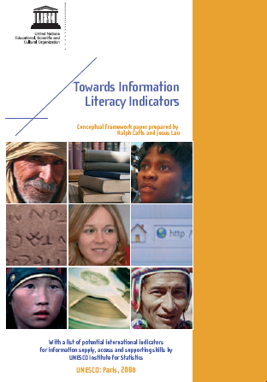
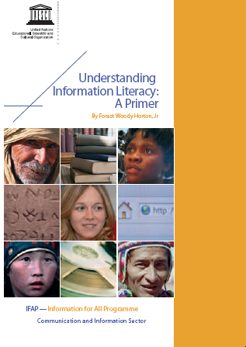
Notes:
On the UNESCO website you’ll find these publications

Slide 33
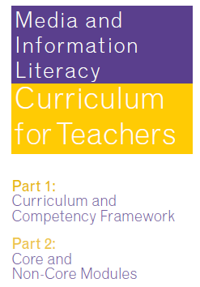
unesdoc.unesco.org/images/0019/001929/192971e.pdf

Slide 34
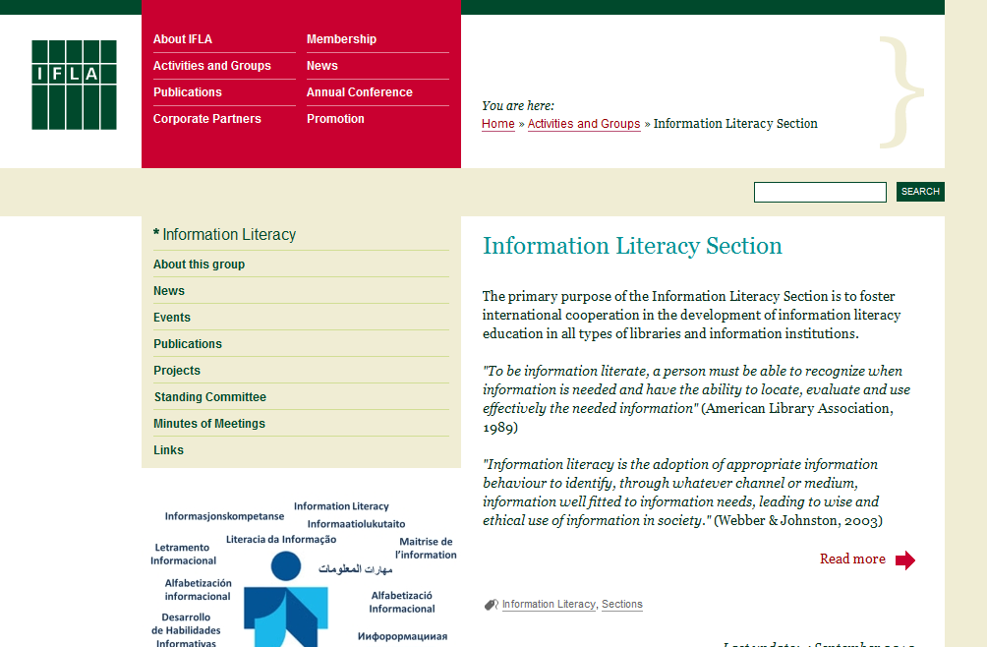
http://www.ifla.org/en/information-literacy

Slide 35

http://www.iasl-online.org/

Slide 36
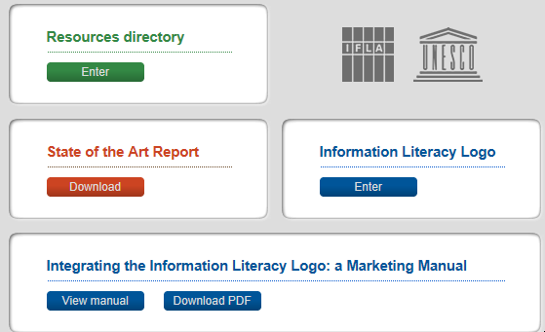
http://www.infolitglobal.info/en/

Slide 37
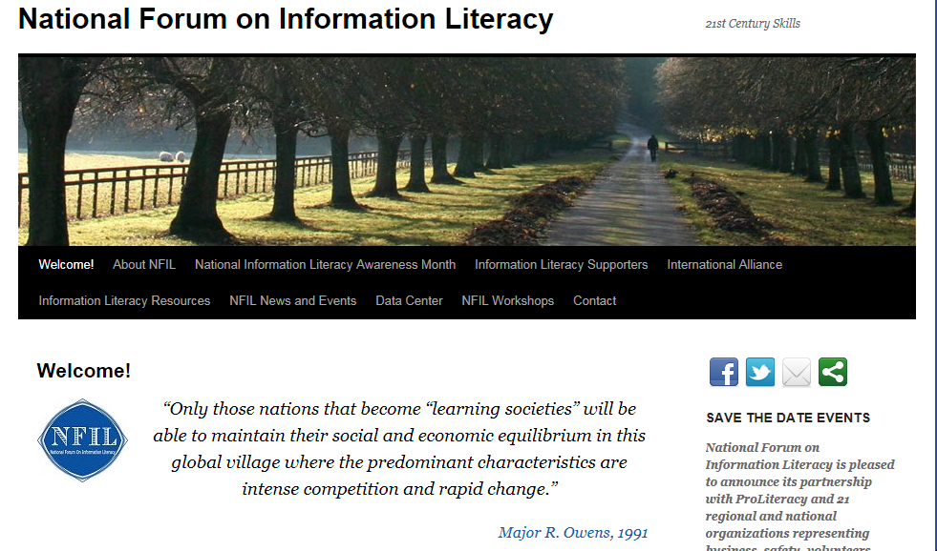
www.infolit.org

Slide 38
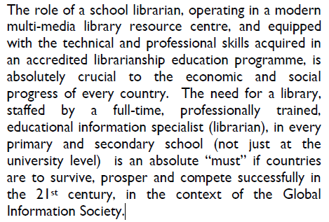
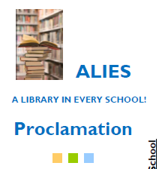
http://www.facebook.com/home.php#!/ALibraryInEverySchool

Slide 39



Reactions
albertkb@gmail.com
albertkb.nl
Notes:
Thank you for your attention. I’ll put the presentation on my website. If you want to react: here is my e-mailadress. Muito obrigado

