Slide 1





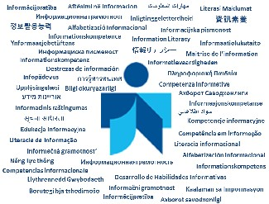
(M)IL And Its Kind
Albert K. Boekhorst
UNESCO
Paris 2012
Notes:
I’m an information scientist, retired from the University of Amsterdam in the Netherlands and still a visiting professor at the University of Pretoria, South Africa. My research concentrates on the access to information, especially on information literacy and the role of (school) libraries. Among others I’m the Information Officer of the IFLA Information Literacy section, member of IFLA School Libraries and Resource Centers section, member of the board of ENSIL and member of IASL and the Dutch Library Association. I participated in several UNESCO Expert Group Meetings on Media and Information Literacy and coordinated and participated in the worldwide UNESCO TtT in Information Literacy workshops series.

Slide 2
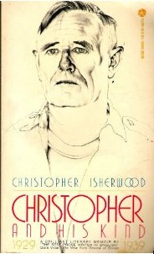

Christopher And His Kind, 1929 - 1939
by Christopher Isherwood

Slide 3
Content
Informatisation of Society
Information Literacy
Related terms
Media and Information Literacy

Slide 4
Information Science
‘… an interdisciplinary science that investigates the properties and behaviour of information, the forces that govern the flow and use of information, and the techniques, both manual and mechanical, of processing information for optimal storage, retrieval, and dissemination.’
…
‘It has both a pure science and an applied component’
(Borko 1968)

Slide 5
Aspects
properties and behaviour of information
flow and use of information
processing of information
    (manual and mechanical)

Slide 6
Restrictions
Stored information
Communication between people

Slide 7
Three levels:
Macro = ‘World’ society as a whole
Meso = Organisational
Micro = Individual
→ private, professional

Slide 8
Informatisation of society
…theoretical perspective for the process in which information is becoming the dominant production factor in society

Slide 9
Informatisation paradigm
Based on:
Sociological perspective
  long term development
  →Civilizing process
  discontinuous change
  →’Revolutions’
Information Science perspective

Slide 10
Informatisation process
Ongoing control over natural forces
→ ‘technization
Ongoing differentiation: social and technical
→ ‘differentiation’
Expanding of interdependency networks
→ ‘globalisation’
Notes:
If we look at a long-term development over the ages we can see three developmetns in what I call the informatisation process :
An ongoing contral over natural forces > technization
An ongoing social and technical differentiation > differentiation
An expanding of interdependency networks > globalisation

Slide 11
Information continuum
wisdom
knowledge
information
data
facts

Slide 12
Information cycle
wisdom
knowledge
knowledge
information
information
information
data
data
data
facts
facts

Slide 13
Knowledge growth
i
i
’
i
’
’
a
a
’
a
’
’
k
e
k’
k
’
’
’
e
’
e
’
’
k
’
’
’
Notes:
Dervin

Slide 14
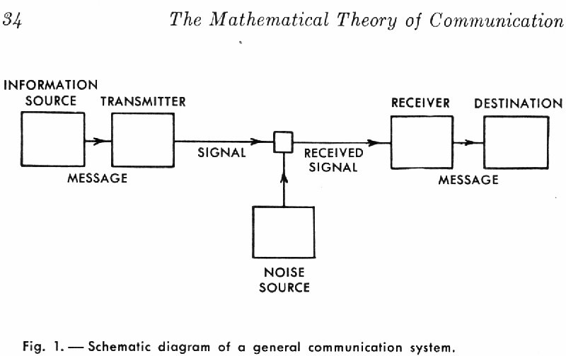

Slide 15

Shannon & Weaver (1948)
Notes:
The Shannon–Weaver model of communication has been called the "mother of all models."^{[1]} It embodies the concepts of information source,message, transmitter, signal, channel, noise, receiver, information destination, probability of error, encoding, decoding, information rate, channel capacity, etc.
In 1948 Claude Elwood Shannon published A Mathematical Theory of Communication article in two parts in the July and October numbers of the Bell System Technical Journal.^{[2]} In this fundamental work he used tools in probability theory, developed by Norbert Wiener, which were in their nascent stages of being applied to communication theory at that time. Shannon developed information entropy as a measure for the uncertainty in a message while essentially inventing what became known as the dominant form of "information theory."
The book co-authored with Warren Weaver, The Mathematical Theory of Communication, reprints Shannon's 1948 article and Weaver's popularization of it, which is accessible to the non-specialist.^{[3]} Shannon's concepts were also popularized, subject to his own proofreading, in John Robinson Pierce'sSymbols, Signals, and Noise.^{[4]}
The term Shannon–Weaver model was widely adopted into social science fields such as education, organizational analysis, psychology, etc. In engineering andmathematics, Shannon's theory is used more literally and is referred to asShannon theory, or information theory.^{[5]}
^{Source} http://en.wikipedia.org/wiki/Shannon%E2%80%93Weaver_model

Slide 16
To survive, relax, develop etc.
People, organisations and nations need knowledge on:
Themselves
Their physical environment
Their social environment
Notes:
People need knowledge to survive, to develop, to relax, to perform tasks, make decisions and solve problems. ... They need knowledge on themselves, their physical environment and their social environment

Slide 17
Information Space
Observation: objects & processes
Conversation: persons
Consultation:
  Stored / recorded information in
Libraries, Archives, Museums, Information institutes etc.
‘memory institutions’
Both real and virtual
Notes:
They can find this information in their information space via 3 processes: Observation, Conversation and Consultation.
Observation refers to the ability to look around and observe objects and processes, this is fact-finding by experimenting and authenticating. If I want to know if it’s raining so I’ll take an umbrella, I look out of the window and make a decision.
Conversation refers to the process in which we ask other people: family, friends, colleagues and experts for the information we need, face-to-face, by phone, by e-mail. So if I want to know if I have to take an umbrella, I can call my sister and ask her. She can look out of the window and decide, maybe she can even inform me better, because she has heard the weather forecast.
Consultation refers to the process in which we consult information professionals working in libraries, archives, museums, information institutes and information departments in organisations. This is called stored or recoded information. Due to technology push and users demands long existing walls and traditions between them are disappearing and we call them ‘memory institutions’ now.
All three processes take place in the ‘real’ world were we can touch the objects and the ‘virtual’ world, that we can only access with digital technology.

Slide 18
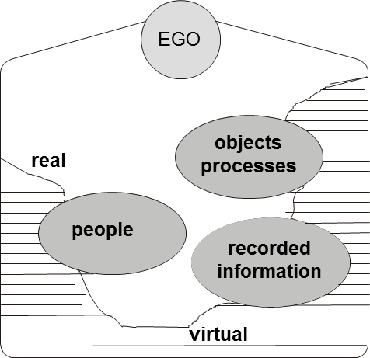
Personal information space
Notes:
Each of us has a personal information space were we can find the relevant information resources. It’s created automatically when we are born and it develops and expands during our lifetime when we grow older: our learning and working carrier, our social contacts and so on. When we grow very old the information space will shrink again.

Slide 19
Barriers
Economic
Political
Affective
Cognitive
Personal characteristics
Notes:
However, there are barriers that impede or can even block successful access to needed information. Till now I distinguished four types of potential barriers that are based on interdependencies between people: economic, political, affective and cognitive. Today I add a fifth one personal characteristics
The economic barrier refers to the fact that people are dependent on the production and the distribution of scarce resources including food, clothing and housing. Since the 1970s information is considered as the fourth production factor, which functions as the driving force of the economy. This means that supply and demand factors are applicable to the production, use and control of information and the technical and social infrastructure that is needed for access to information and dissemination. Information costs money. As wealth is unevenly spread the access to information is spread unevenly as well.
The political barrier refers to people's need to protect themselves against physical constraints and aggression of others. To obtain this protection a regulation of violence is needed whereby specialists can enforce power entitled to them through legislation. Hereby the law and order of a society is formally stipulated. These rules have reference to all relations people have with one another. Laws regarding information are for example the regulation of author's rights, legislation on archives, access to government information and freedom for the press. These forms of legislation can be seen as political regulation through which access to information can be controlled. I think of nations that try to block the access to internet and Wikileaks.
The affective barrier refers to the fact that people have feelings for one another. People need one another for affection, love and support. These friendships and emotional relations are not limited only to other people, but also include objects and organisations that are appropriate to a person's culture. Therefore information sources and channels such as books, CDs, DVD’s television and internet are also included. This liking has reference to not only the information media, and channel, but also the information type itself.
The cognitive barrier refers to the fact that people are dependent on one another because they learn from one another. People create knowledge and distribute this between one another in the form of information. Until the development of writing, people communicated mainly through speech and verbal communication. Writing and printing made it possible for information to be disseminated in spite of borders of time and space. Learning from one another happens in diverse ways and is not limited to education at school. The scope and content of what is taught to the people depend on their social position and societal relations. An illiterate farm worker in the 18th century was not as affected by his or her illiteracy as an illiterate person in the first decade of the 21st century in Western society.
The personal characteristics barrier refers to the fact that people are of equal value, but are not equal.: They differ in gender, lenght, social environment and so on. And which is relevant for this presentation they can differ in abilities. In some cases when the differences are significant big we speak of disabillites I’ll come back to that later.

Slide 20
‘Survival of the Fittest’
Those who are better than others capable to satisfy their information needs in an effective and efficient way, are more capable to survive and develop themselves than … those with less advantageous traits ...
After Charles Darwin
"...it is not the strongest of the species that survive, nor the most intelligent, but the one most responsive to change...“
Therefore a need to be ‘Information Literate’
Notes:
Those who are better than others capable to satisfy their information needs in an effective and efficient way, are more capable to survive and develop themselves than … those with less advantageous traits ...
After Charles Darwin
"...it is not the strongest of the species that survive, nor the most intelligent, but the one most responsive to change...“
Therefore a need to be ‘Information Literate’

Slide 21
Effects for people
Exponential growth of information, information media, information channels and information services
Growth of technology, tools and applications to retrieve, process and disseminate information
Changes in communication patterns and behaviour
‘Connected’ 24/7

Slide 22

21st century
Working ‘In the Cloud’
Notes:
What we see is an ongoing working in the cloud. No longer do we carry our information with ourself, printed, on cd, dvd or on a stick. The only thing we need is some device, from cell phone to tablet to computer, electricity and a subscription of a provider. But that all needs money ….

Slide 23
In how many clouds?
Notes:
What we see is an ongoing working in the cloud. No longer do we carry our information with ourself, printed, on cd, dvd or on a stick. The only thing we need is some device, from cell phone to tablet to computer, electricity and a subscription of a provider. And in how many ‘clouds’ are we working? Seperate ones for work and entertainmaent? But that all needs money ….

Slide 24

Need to be able to work time, place and hard/software independed

Slide 25
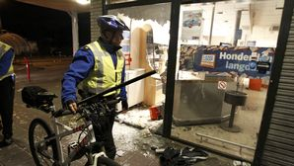
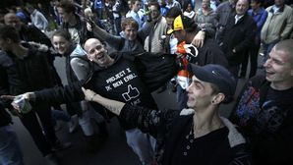
Facebook Party in Haren

Slide 26
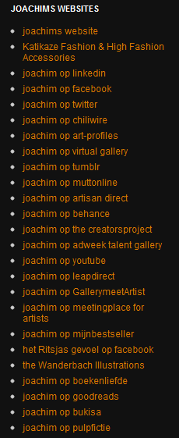

Slide 27
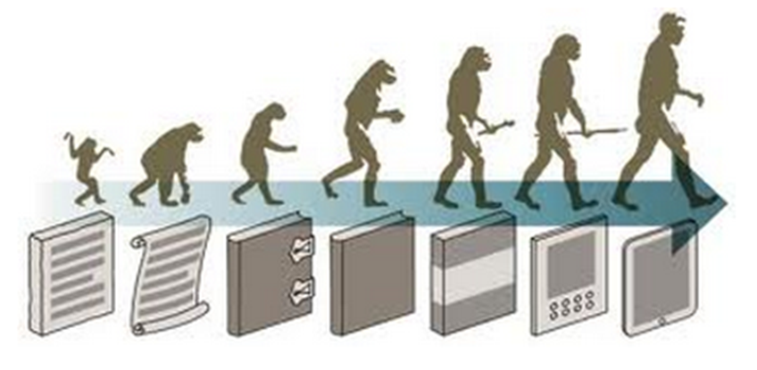
Information literacy
Increasing complexity of environment leads to need for more skills to select, retrieve and process information
External factors create backlog

Slide 28
First time mentioned
Paul Zurkowski was the originator of the term "information literacy". He first used it in 1974 in a proposal to the US National Commission on Libraries and Information Science. At the time he coined the term he was president of the Information Industry Association.
Notes:
Zurkowski: “The Information Services Environment: Relationship and Priorities”. Related paper no 5. National Commission on Libraries and Information Science
Right from the go – Zurkowski heads his prologue “The Goal: Achieving Information Literacy”; he then goes on to state we experience an overabundance of information whenever available information exceeds our capacity to evaluate it. He claims that this is a universal condition and lists three reasons: 1) That information seeking differs according to time and purpose; 2) There is a multiplicity of sources and access routs resulting in a kaleidoscopic approach taken by people; 3) more human experience is being dealt with in information equivalents. Talking about the then commercial shape of publishing, Zurkowski uses the analogyof an information “prism” gathering “light” (ideas and concepts) and then performing a variety of “refracting” functions (editing, encoding, printing, microfilming, arranging etc) to produce a spectrum of products, services and systems to meet the kaleidoscopic needs of the user. People who are trained in the application of information resources to their work can be called information literate (p.6). It is important to remember that Zurkowski is talking about the access and dissemination of information in the workplace as an economic benefit and necessity, calling on the National Commission to commit to a major national education programme to achieve universal information literacy by 1984; presently he estimates that only one-sixth of the US population are information literate.

Slide 29
‘People trained in the application of information resources to their work can be called information literates. They have learned techniques and skills for utilizing the wide range of information tools as well as primary range of information tools as well as primary resources in molding information-solutions to their problems’
(Zurkowski 1974, p.6).

Slide 30
American Library Association (1989)
Information literacy is a set of abilities requiring individuals to recognize when information is needed and have the ability to locate, evaluate, and use effectively the needed information
In an ethical way

Slide 31
Further
2003 Prague Declaration
  "Towards an Information Literate Society" and Information Society
2005 Alexandria Declaration
  Beacons of the Information Society
2011 Fez Declaration on Media & Information Literacy
2012 UNESCO / IFLA Recommendation
  Dilemma IL or MIL …
2012 Moscow Declaration on Media and Information Literacy
Notes:
The 2003 Prague Declaration was called
"Towards an Information Literate Society" made the connection to the information socity
The 2005 Alexandria Declaration
Beacons of the Information Society to Life long learning
At the moment we are working at a UNESCO / IFLA Recommendation for Media and Information literacy. UNESCO can ask members states to rapport on items for which UNESCO developed a Recommendation. I have drafted the first versions and it’s now under revision.

Slide 32
Information Rich - Poor
person
rich
C’
A’
C
A
poor
rich
environment
B
D
A = Information Rich person in Information Rich environment
B = Information Poor person in Information Poor environment
poor
C = Information Rich person in Information Poor environment
D = Information Poor person in Information Rich environment
Notes:
We can describe an environment as information rich, when there is the possibility to access to all kind of information resources and channels and memory institutions. The opposite we call information poor.
An information rich person is an information literate persons , that is able to use the variety of information in an efficient and effective way. He/she is able to life-long-learning and to be able to develop him/herself. An information poor person can’t.
This gives us four theoretically four situations
A an information rich person in an information rich environment.
Like here all of you in Sao Paulo. You are able to use the channels to satisfy your information needs.
B is the opposite: an information poor person in a information poor environment. This person is not even to use the few information resources that might be possible
c Information rich person in an information poor environment.
Last December I made a boot trip on the Amazone river …. We visited some places where there is no access to whatever source
So that was a week without internet …..
The last one an information poor person in an information rich environment. That person can learn to become information literate and use the possibilities adequately
And what happens now: I showed earlier how our societies are developing. The complexity and possibilities expand. So the environment is becoming more ‘Rich’. Person C and person A are still ‘information Rich’ because they learned how to develop themselves. The gap, the distance between B and D and A and C has grown.

Slide 33
Involvement
former Advisory Council for Librarianship and Information Services Informatievaardigheden in het onderwijs / Den Haag : RABIN 1993
ISBN: 9072278232
Informatievaardig / ‘Information proficient’
Informatievaardigheden / Information Literacy

Slide 34
Aspects
Recognition information need
Translation information need into query
Identification suitable information source
Application knowledge of relevant ICT
Selection, integration, dissemination of found information.
Continuous evaluation

Slide 35
Process
E5
1
2
3
4
5
recognize
information
need
formulate
information
query
knowledge
information
sources
knowledge
of ICT
appliations
selection
intergration
dissemination
K
K’
E1
E2
E3
E4
1
= knowledge product
E1
= evaluation moment
Notes:
Next to many definitions, there are many models. I developed this one many years ago. It shows how a person comes from Knowledg moment K to K’. It has Knowledge products and evaluation moment.

Slide 36
SCONUL 7 pillars of information literacy
Recognise information need
Basic Library Skills
&
IT Skills
Distinguish ways of addressing gap
Construct strategies for locating
Locate and access
Information Literacy
Compare and evaluate
Organise, apply and communicate
Synthesise and create
http://www.sconul.ac.uk/
Notes:
This is another one British SCONUL 7 pillars of information literacy

Slide 37
Related terms
Information
competencies
User
education
User training
Information
literacy
Bibliographic
instruction
Library
orientation
Information
fluency
Information
skills
Notes:
There are a lot of terms sometimes used synonymously with IL. For me IL so far was an embrella concept and all other terms can be considered components of it (?)
Information fluency – Mastery of information competencies
User education – Global approach to teach information access to users
Library instruction – Focuses on library skills
Bibliographic instruction – User training on information search and retrieval
Information competencies – Compound skills and goals of information literacy
Information skills – Focuses on information abilities

Slide 38
Harris & Hodges (1995)
Adult literacy
Advanced literacy
Basic literacy
Biliteracy
Community literacy
Computer literacy
Critical literacy
Cultural literacy
Emergent literacy
Family literacy
Functional literacy
Informational literacy
Marginal literacy
Media literacy
Minimal literacy
Restricted literacy
Survival literacy
Visual literacy
Workplace literacy
Notes:
Already in 1995 Harris and Hodges found 19 related terms. I think today I can find many more.

Slide 39
More …
Tool literacy,
Resource literacy,
Social-structural literacy,
Research literacy,
Publishing literacy,
Emerging technology literacy,
Critical literacy.
Shapiro, & Hughes,1996

Slide 40
Recently found
Civic Literacy
News Literacy
Information Fluency
Health information Literacy
Emergent Literacy
Transliteracy
Copyright Literacy
Century Skills
21st Century Information Fluency
Augmented Reality Literate
Visual Literacy
Mobile Information Literacy
Chat Literacy

Slide 41
Dutch Council for Culture
1996: Advice media education
  Media Wisdom
HITS
  Mediawijsheid 41.400
  Informatievaardigheden 10.800
  Google Chrome 23-6-2012

Slide 42
IL and Media Literacy
Expert meetings UNESCO
  Paris June 2008
    Teacher Training Curricula for Media and information Literacy
  Bangkok November 2010
    Towards Media and Information Literacy Indicators

Slide 43
Definition
Media literacy is a repertoire of competences that enable people to analyze, evaluate, and create messages in a wide variety of media modes, genres, and forms.
http://en.wikipedia.org/wiki/Media_literacy

Slide 44
Umbrella concept
Information
Literacy
User
education
User training
Bibliographic
instruction
Information
competencies
Library
orientation
Information
fluency
Information
skills
Notes:
There are a lot of terms sometimes used synonymously with IL. For me IL is an embrella concept and all other terms can be considered components of it (?)
Information fluency – Mastery of information competencies
User education – Global approach to teach information access to users
Library instruction – Focuses on library skills
Bibliographic instruction – User training on information search and retrieval
Information competencies – Compound skills and goals of information literacy
Information skills – Focuses on information abilities

Slide 45
Umbrella concept
MIL
User
education
User training
Bibliographic
instruction
Information
competencies
Library
orientation
Information
fluency
Information
skills
Notes:
There are a lot of terms sometimes used synonymously with IL. For me IL is an embrella concept and all other terms can be considered components of it (?)
Information fluency – Mastery of information competencies
User education – Global approach to teach information access to users
Library instruction – Focuses on library skills
Bibliographic instruction – User training on information search and retrieval
Information competencies – Compound skills and goals of information literacy
Information skills – Focuses on information abilities

Slide 46
3 concepts
The ICT concept:
  Information literacy refers to the competence to use ICT to retrieve and disseminate information.
The information (re)sources concept:
  Information literacy refers to the competence to find and use information independently or with the aid of intermediaries.
The information process concept:
  Information literacy refers to the process of recognizing information need, the retrieving, evaluating, use and dissemination of information to acquire or extend knowledge.

Slide 47
Information inequality
Excluded
Participating majority
Information elite
Notes:
There is a lot of information inequalty; We can distinguis an information elite, a participating majority and the excluded. And these groups and not evenly devided over the world.

Slide 48
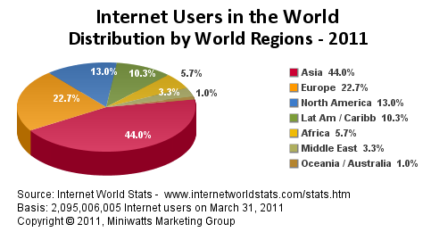

Slide 49
So far ‘MIL’
Is a container concept
It’s a dynamic concept
Being ‘MIL’ is a competence:
  a critical Attitude about:
    What am I doing?
    What for am I doing this?
    With what am I doing this?
  Knowledge about:
    the organization and quality of information resources and -channels
    acquiring access to information
  Skills: being able to use required skills and technology
Part of Life Long Learning

Slide 50
How: by learning
In the socialisation process:
  ‘By doing’
  Formal education
  Informal education

Slide 51
Becoming information literate
Cannot be learned in a distinct subject
Integrated in any subject
Coordination between ‘teachers’ & ‘librarians’

Slide 52
In each subject attention for:
Information problems: what are relevant problems in the subject?
Information questions: how are questions in this subject formulated?
Resources: what specific information resources are relevant for the subject?
Selecton: which of the identified sources are relevant
Process: what specific communication tradition are there regarding presentation, storing and dissemination
ICT: what specific skills are needed to use resources and applications
Evaluation: Does each step indeed lead to obtain the desired information and satisfies the information need

Slide 53
+
Aspects of information literacy should be given in such a way that they reflect the needs of the person at that time.

Slide 54
Learning Line & Moments
Life Long Learning
Educational level C
curriculum
Educational level B
Educational level A
time

Slide 55
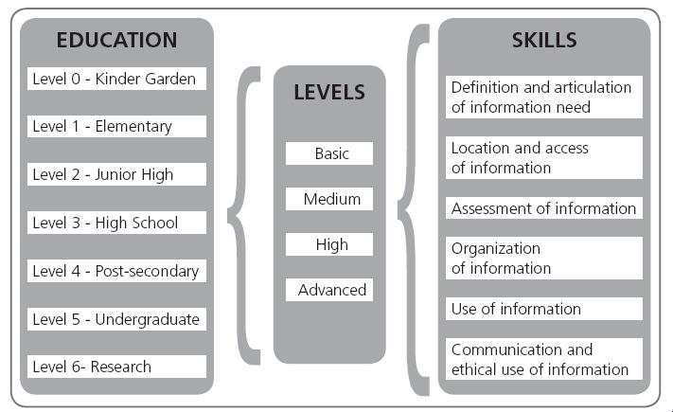
Information Literacy Continum
Catts & Lau 2008

Slide 56
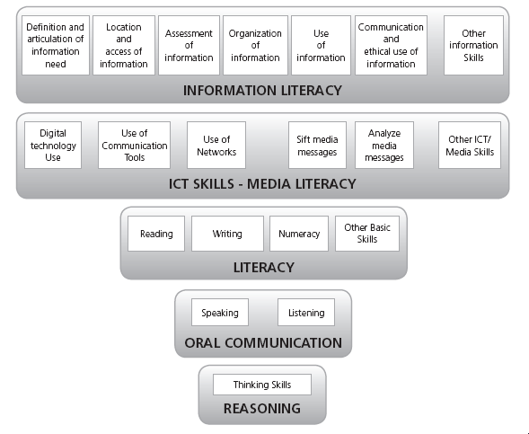
Catts & Lau 2008

Slide 57
Towards becoming MIL
From
  Unconscious Incompetent
Via
  Conscious Incompetent
To
  Conscious Competent

Slide 58
Via Assessments
Self-assessment
Peer-assessment
Tutor-assessment

Slide 59
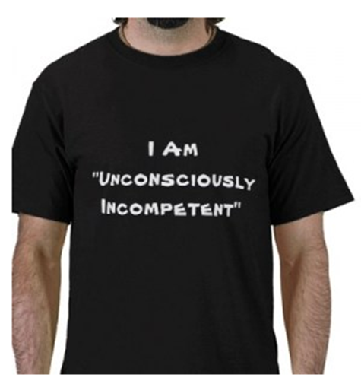
How?
unconscious
incompetent
step 1 raise awareness
(assessment)
conscious
incompetent
step 2 offer trainings
conscious
competent
©akb
59
Notes:
59

Slide 60
Global Trends
Originated in ‘industry’
Went into (school) libraries
Differentiation of concept
Confusing variety of ´terms
Is still there, more and more ´integrated´
But still:
  Lack of interest of ‘management’
  Reluctance of ‘teachers’

Slide 61
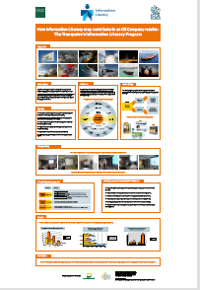

Slide 62
Thank you
Reactions:
albertkb@gmail.com
albertkb.nl
Notes:
Thank you for your attention. I’ll put the presentation on my website. If you want to react: here is my e-mailadress. Muito obrigado

