Slide 1




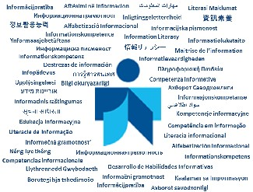


School Libraries:
Open Windows to the World
Prof.dr. Albert K. Boekhorst
Dhaka, Bangladesh
25-27 April 2019

Slide 2



To survive, develop, perform tasks, solve problems, relax etc.
People, organisations and nations need knowledge on:
Themselves
Their physical environment
Their social environment
Notes:
People need knowledge to survive, to develop, to relax, to perform tasks, make decisions and solve problems. ... They need knowledge on themselves, their physical environment and their social environment

Slide 3
Information Space
Observation: objects & processes
Conversation: persons
Consultation:
  Stored / recorded information in
Libraries, Archives, Museums, Information institutes etc.
‘memory institutions’
Both real and virtual
Notes:
They can find this information in their information space via 3 processes: Observation, Conversation and Consultation.
Observation refers to the ability to look around and observe objects and processes, this is fact-finding by experimenting and authenticating. If I want to know if it’s raining so I’ll take an umbrella, I look out of the window and make a decision.
Conversation refers to the process in which we ask other people: family, friends, colleagues and experts for the information we need, face-to-face, by phone, by e-mail. So if I want to know if I have to take an umbrella, I can call my sister and ask her. She can look out of the window and decide, maybe she can even inform me better, because she has heard the weather forecast.
Consultation refers to the process in which we consult information professionals working in libraries, archives, museums, information institutes and information departments in organisations. This is called stored or recoded information. Due to technology push and users demands long existing walls and traditions between them are disappearing and we call them ‘memory institutions’ now.
All three processes take place in the ‘real’ world were we can touch the objects and the ‘virtual’ world, that we can only access with digital technology.

Slide 4
Barriers to information
Economic
Political
Affective
Cognitive
Personal characteristics
Notes:
However, there are barriers that impede or can even block successful access to needed information. Till now I distinguished four types of potential barriers that are based on interdependencies between people: economic, political, affective and cognitive. Today I add a fifth one personal characteristics
The economic barrier refers to the fact that people are dependent on the production and the distribution of scarce resources including food, clothing and housing. Since the 1970s information is considered as the fourth production factor, which functions as the driving force of the economy. This means that supply and demand factors are applicable to the production, use and control of information and the technical and social infrastructure that is needed for access to information and dissemination. Information costs money. As wealth is unevenly spread the access to information is spread unevenly as well.
The political barrier refers to people's need to protect themselves against physical constraints and aggression of others. To obtain this protection a regulation of violence is needed whereby specialists can enforce power entitled to them through legislation. Hereby the law and order of a society is formally stipulated. These rules have reference to all relations people have with one another. Laws regarding information are for example the regulation of author's rights, legislation on archives, access to government information and freedom for the press. These forms of legislation can be seen as political regulation through which access to information can be controlled. I think of nations that try to block the access to internet and Wikileaks.
The affective barrier refers to the fact that people have feelings for one another. People need one another for affection, love and support. These friendships and emotional relations are not limited only to other people, but also include objects and organisations that are appropriate to a person's culture. Therefore information sources and channels such as books, CDs, DVD’s television and internet are also included. This liking has reference to not only the information media, and channel, but also the information type itself.
The cognitive barrier refers to the fact that people are dependent on one another because they learn from one another. People create knowledge and distribute this between one another in the form of information. Until the development of writing, people communicated mainly through speech and verbal communication. Writing and printing made it possible for information to be disseminated in spite of borders of time and space. Learning from one another happens in diverse ways and is not limited to education at school. The scope and content of what is taught to the people depend on their social position and societal relations. An illiterate farm worker in the 18th century was not as affected by his or her illiteracy as an illiterate person in the first decade of the 21st century in Western society.
The personal characteristics barrier refers to the fact that people are of equal value, but are not equal.: They differ in gender, lenght, social environment and so on. And which is relevant for this presentation they can differ in abilities. In some cases when the differences are significant big we speak of disabillites I’ll come back to that later.

Slide 5
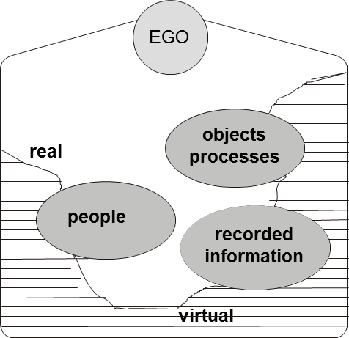
Personal information space
Notes:
Each of us has a personal information space were we can find the relevant information resources. It’s created automatically when we are born and it develops and expands during our lifetime when we grow older: our learning and working carrier, our social contacts and so on. When we grow very old the information space will shrink again.

Slide 6
Cyberspace
Technization
  Ongoing use of technology
Differentiation
  More and more specific items/services/institution
Globalization
  Expantion of relations to networks worldwide

Slide 7
Effects
Exponential growth of information, information media, information channels and information services
Growth of technology, tools and applications to retrieve, process and disseninate information
Changes in communication behaviour
Being ‘connected’ 24/7

Slide 8

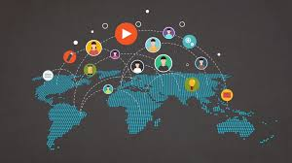
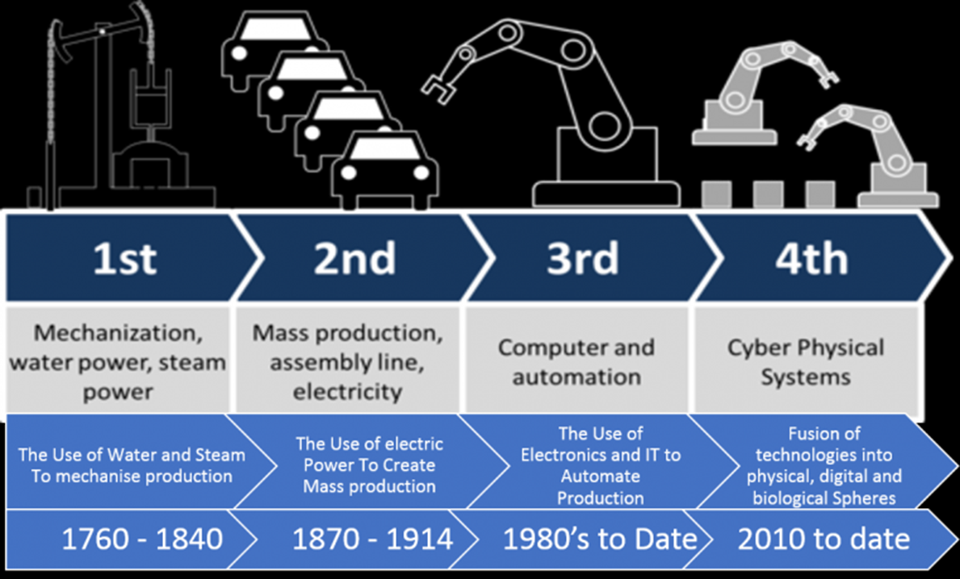
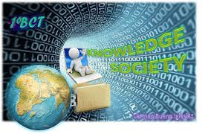
Information Society
Knowledge Society
4IR 4th Information revolution

Slide 9

21st century
Working ‘In the Cloud’
Notes:
What we see is an ongoing working in the cloud. No longer do we carry our information with ourself, printed, on cd, dvd or on a stick. The only thing we need is some device, from cell phone to tablet to computer, electricity and a subscription of a provider. But that all needs money ….

Slide 10
In how many clouds?
Notes:
What we see is an ongoing working in the cloud. No longer do we carry our information with ourself, printed, on cd, dvd or on a stick. The only thing we need is some device, from cell phone to tablet to computer, electricity and a subscription of a provider. And in how many ‘clouds’ are we working? Seperate ones for work and entertainmaent? But that all needs money ….

Slide 11

Social Media

Slide 12

Social media

Slide 13
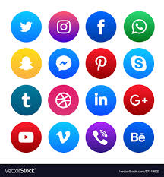
Social Media

Slide 14
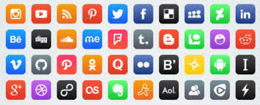
Social Media

Slide 15
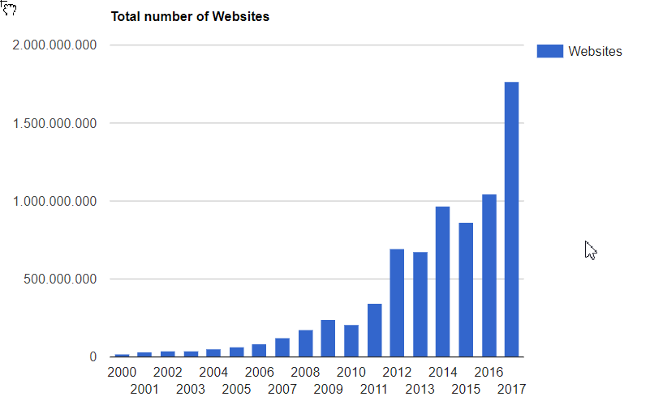
1,681,518,042
Websites online right now
http://www.internetlivestats.com/total-number-of-websites/

Slide 16
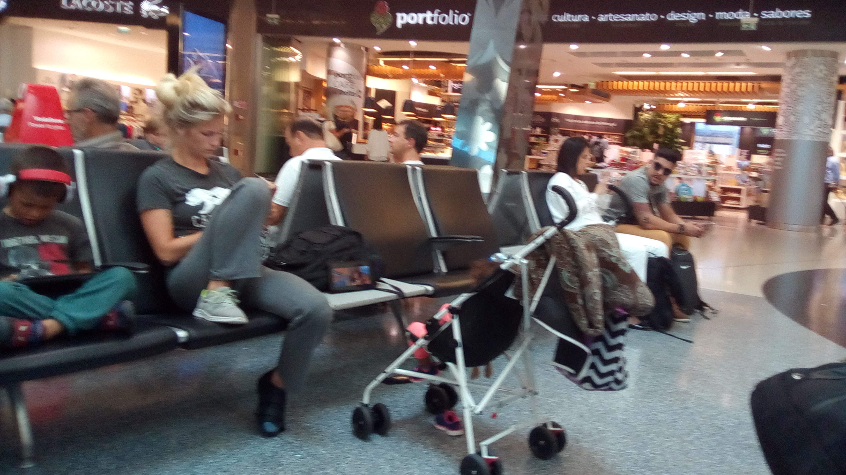
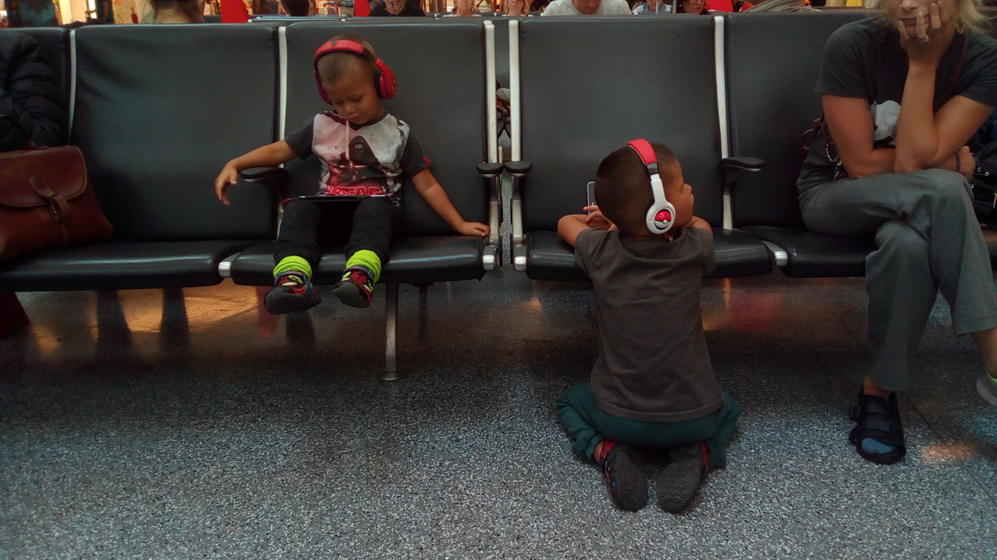
Airport Lisbon 2017

Slide 17
‘Managing’ information has to be learned
How?
In the socialisation process:
  ‘By doing’
  Formal education
  Informal education
Notes:
en hiervan leren we ‘al doende’, in het formele onderwijs ‘op school’ en informeel, tijdens cursussen en opleidingen buiten het onderwijsstelsel van de overheid.
Onze eerste ervaringen over het omgaan met informatie en informatiedragers vindt plaats in het gezin. Als kind leerde ik stil te zijn tijdens de nieuwsberichten, het belang van de krant..

Slide 18
Governments
National governments have a specific responsibility and role in formal education.
  They are taking care of the infrastructure and content in which the ‘unknowing’ become ‘knowing’.
  They determine the goals of education and often the way they are to be achieved. Also the physical infrastructure in which the education takes place: building facilities, sport fields and among others the school library.

Slide 19
A school library is …
A school library is a school’s physical and digital learning space where reading, inquiry, research, thinking, imagination, and creativity are central to students’ information-to-knowledge journey and to their personal, social, and cultural growth.
This physical and digital place is known by several terms:
  (e.g., school media centre, centre for documentation and information, library resource centre, library learning commons)

Slide 20
School libraries
A school library is an educational concept ... Not a room with books and or computers.
It enables access to information by learning how to have acces, evaluate and use information in an efficient, effective and ethical way (fact finding)
Are the hart of the educational system
Needs close collaboration between teachers and librarians
And …… attention of all stakeholders

Slide 21
Strong School Libraries Build Strong Students
Research about educational trends and pedagogical models shows the significant difference effective school library services can make on student literacy and learning outcomes.

Slide 22
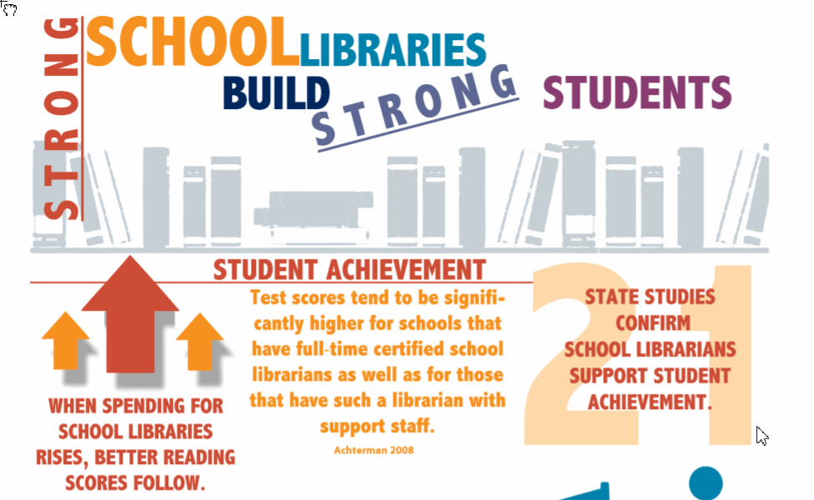
http://www.ala.org/aasl/sites/ala.org.aasl/files/content/aaslissues/advocacy/AASL_infographic.pdf

Slide 23
School Library Policy
Stakeholders:
  School librarians
  School managers
  Teachers
  IT staff
  Volonteers
  Parents
  Students
  Related libraries, i.g Public library

Slide 24
Mission, Vision, Purpose
A mission statement is a concise explanation of the libraries reason for existence.
It describes the libraries purpose and its overall intention.
The mission statement supports the vision and serves to communicate purpose and direction to all stakeholders.

Slide 25


Organisations
National, Part of National Organisation
  AASL, ENSIL, School Library Association Of Bangladesh
International:
Joint IASL/IFLA Committee
IFLA School Libraries Section
International Association
of School Librarianship

Slide 26


Slide 27
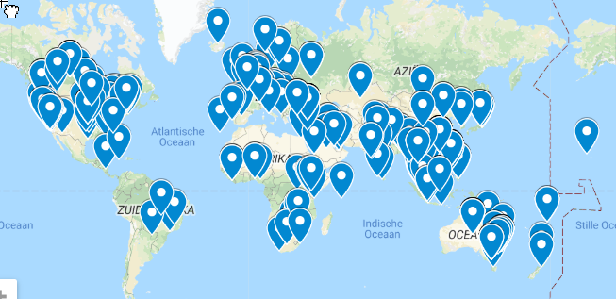
IASL: 1239 members in 76 countries

Slide 28
IFLA/UNESCO School Library Manifesto 1999
The Mission of the School Library
The school library offers learning services, books and resources that enable all members of the school community to become critical thinkers and effective users of information in all formats and media.
+ 9 detailed items
https://www.ifla.org/publications/iflaunesco-school-library-manifesto-1999?og=52

Slide 29
supporting and enhancing educational goals as outlined in the school's mission and curriculum;
developing and sustaining in children the habit and enjoyment of reading and learning, and the use of libraries throughout their lives;
offering opportunities for experiences in creating and using information for knowledge, understanding, imagination and enjoyment;
supporting all students in learning and practising skills for evaluating and using information, regardless of form, format or medium, including sensitivity to the modes of communication within the community;

Slide 30
providing access to local, regional, national and global resources and opportunities that expose learners to diverse ideas, experiences and opinions;
organizing activities that encourage cultural and social awareness and sensitivity;
working with students, teachers, administrators and parents to achieve the mission of the school;
proclaiming the concept that intellectual freedom and access to information are essential to effective and responsible citizenship and participation in a democracy;
promoting reading and the resources and services of the school library to the whole school community and beyond.

Slide 31

IFLA School Library Guidelines, 2nd edition
by IFLA School Libraries Standing Committee, Dianne Oberg and Barbara Schultz-Jones (Eds.)
14 translations

Slide 32
Content: 64 pages
Chapter 1 Mission and Purposes of a School Library
Chapter 2 Legal and Financial Framework for a School Library
Chapter 3 Human Resources for a School Library
Chapter 4 Physical and Digital Resources of a School Library
Chapter 5 Programs and Activities of a School Library
Chapter 6 School Library Evaluation and Public Relations
GLOSSARY
BIBLIOGRAPHY
Appendix A-E

Slide 33
Workshop Implementing
The IASL / IFLA Joint Committee has also developed a set of workshop materials based on the Guidelines. Workshop materials consists of an Introduction and six Modules. The material can be used freely and adapted to meet local needs.
https://www.ifla.org/node/36978

Slide 34
Some observations...
South Africa: 94% of schools have no school library .....
Brasil: Law: In 2020 all schools have a school library ..... Presently 50% at private schools
Denmark: Basic Education Act ensures that there is a school library in all schools
U.S. Public Schools Have Lost Nearly 20% Of Their Librarians Since 2000
UK: School libraries are not a statutory service protected by government

Slide 35
Hossain, Z. (2019). IFLA Journal
In general, it is found that the development of libraries and creating qualified school library professionals have been slow due to a lack of governmental and nongovernmental initiatives.
School libraries where they exist, services and facilities are minimal; school librarians are not integrated with the teaching and learning process.
Finally, the school library is identified being of lesser significance to other priorities in the country's education system and annual budget, and the resulting issues and challenges are, therefore, an important topic and issue of significance.

Slide 36
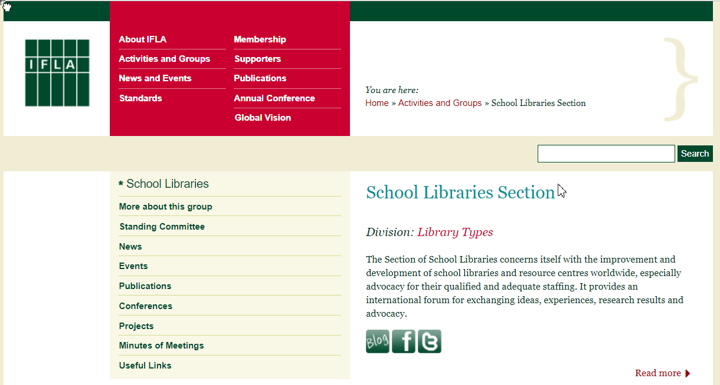
IFLA School Libraries Section
https://www.ifla.org/school-libraries

Slide 37
Mailing List
SCHOOL-L: The purpose of the list will be for better communication between the members of the section and to disseminate minutes, newsletters, etc. throughout the group.
Note: SCHOOL-L is a closed list (restricted to subscribers but open for ALL persons interested in School Libraries ). As of 25th April 2019, there are 463 subscribers.
https://www.ifla.org/about-school-libraries

Slide 38
IFLA Blog
The blog for the School Libraries section has news and current items of interest from school libraries across the world. Edited by Lesley Farmer and Albert K. Boekhorst
https://www.ifla.org/about-school-libraries

Slide 39



Facebook

Slide 40
Thank you
Comments
albertkb@gmail.com
albertkb.nl

